Slide 1


1st Anniversary
November 13, 2021
6:00 pm - 8:00 pm (GMT +3)

Slide 2
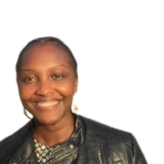
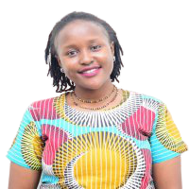
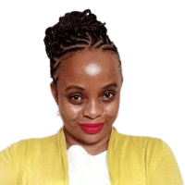
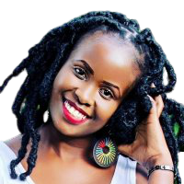
The organisers …
Njoki Lucy
Biostatistician
Faith Musili
Senior Data Analyst
Margaret Wanjiru
Risk Analyst
Shelmith Kariuki
Data Analytics Consultant

Slide 3

The journey …
915 members
654 based in Kenya
Notes:
We have 915 members from different parts of the world, however majority from Nairobi Kenya, 654 members.

Slide 4
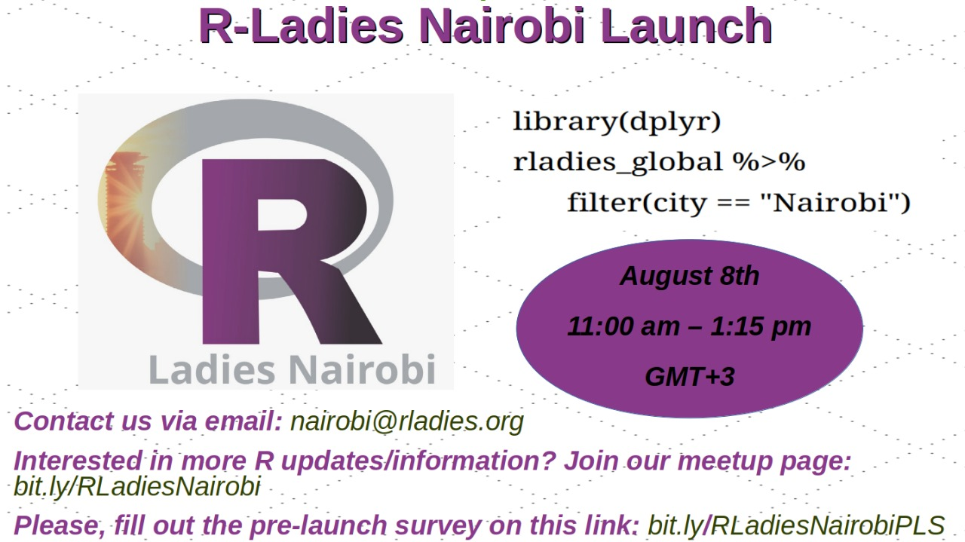
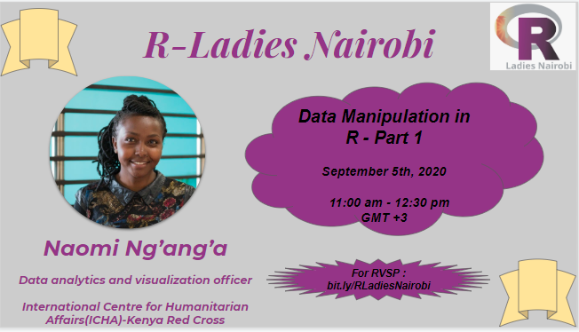
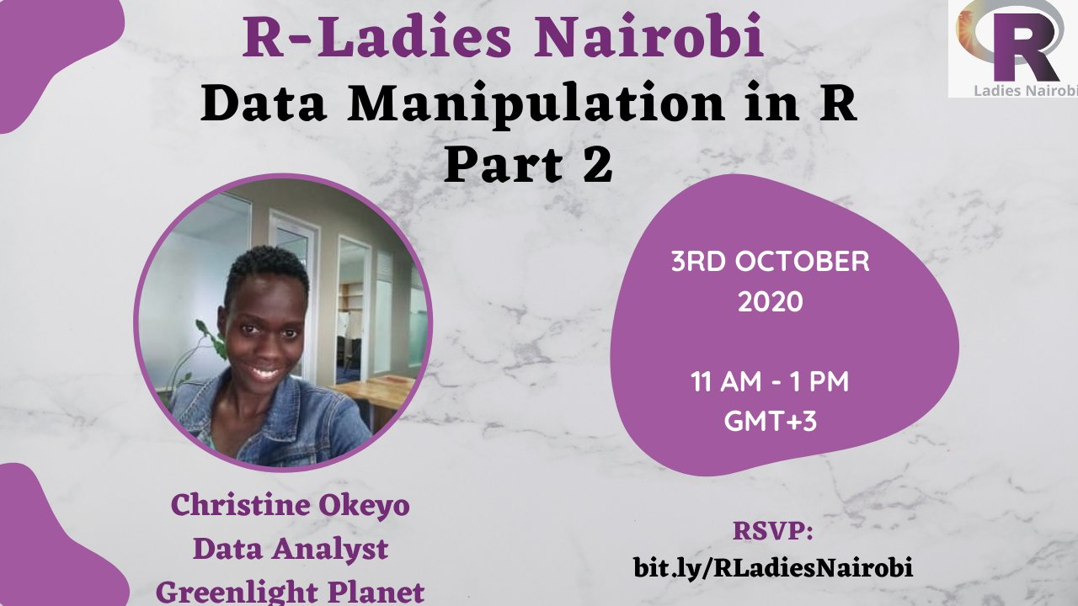
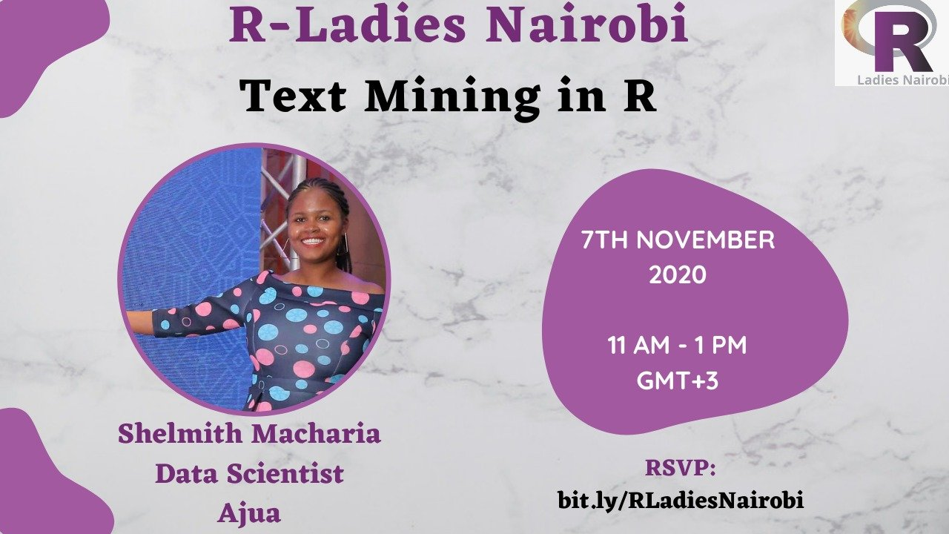
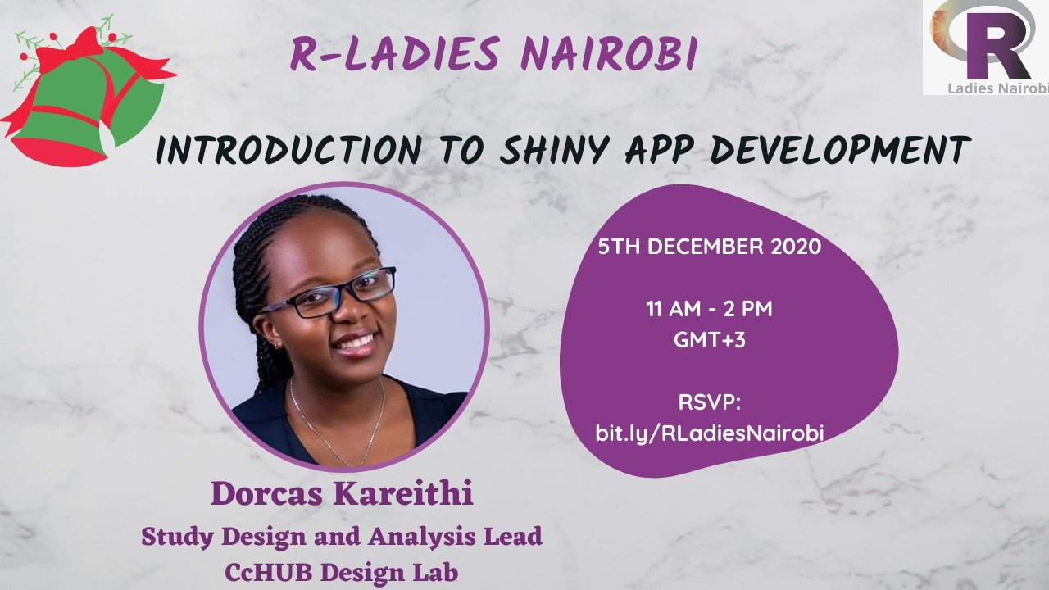
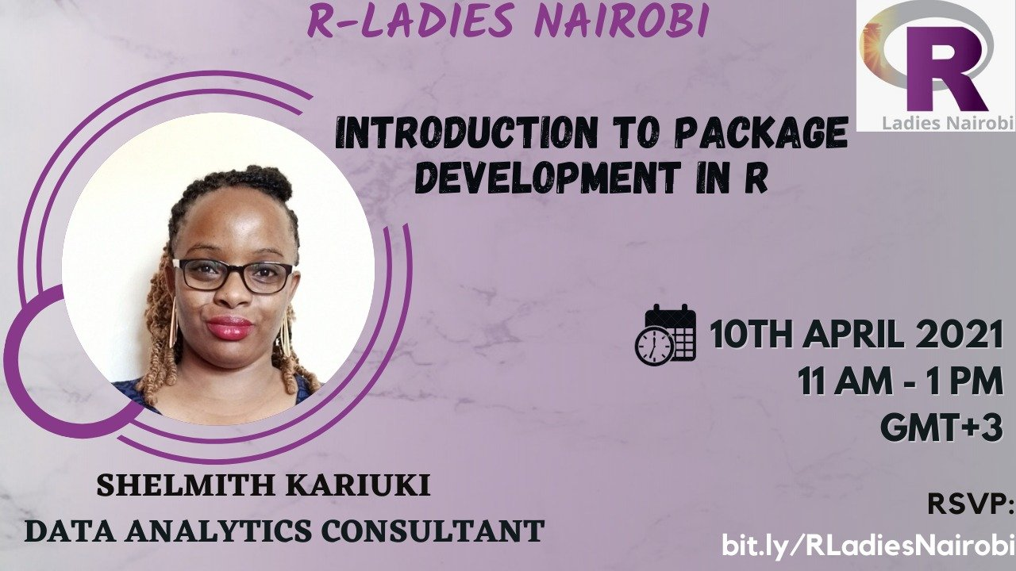
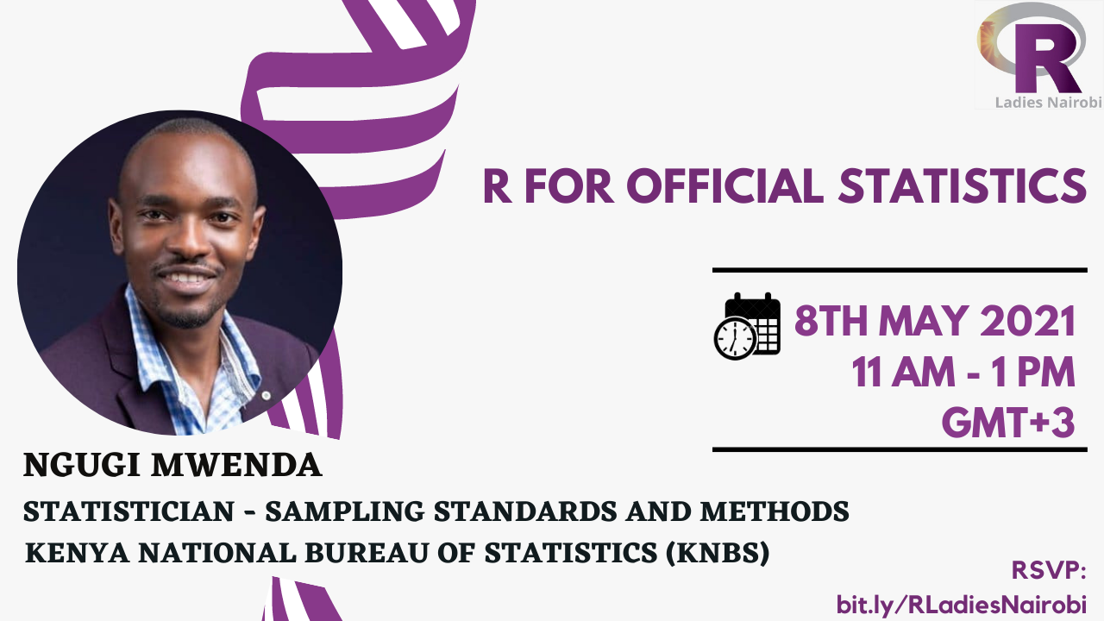
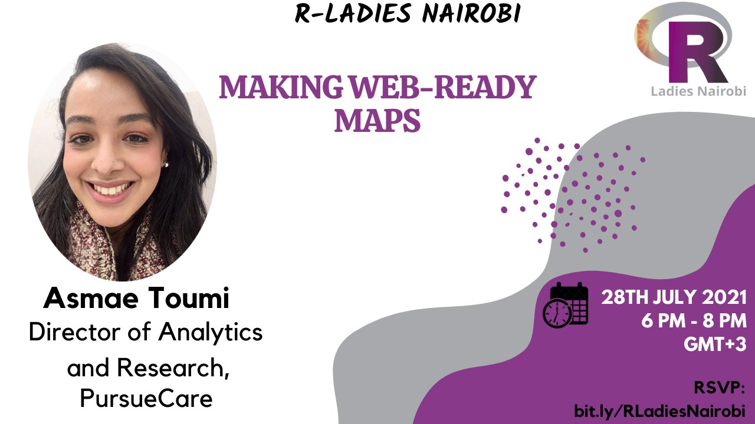
Notes:
We held 10 events including the launch:
data manipulation parts 1 and 2;
text mining
introduction to shiny app development
networks and graphs for Biology in R
intro to package development;
R for official statistics; working with databases;
making web-ready maps

Slide 5
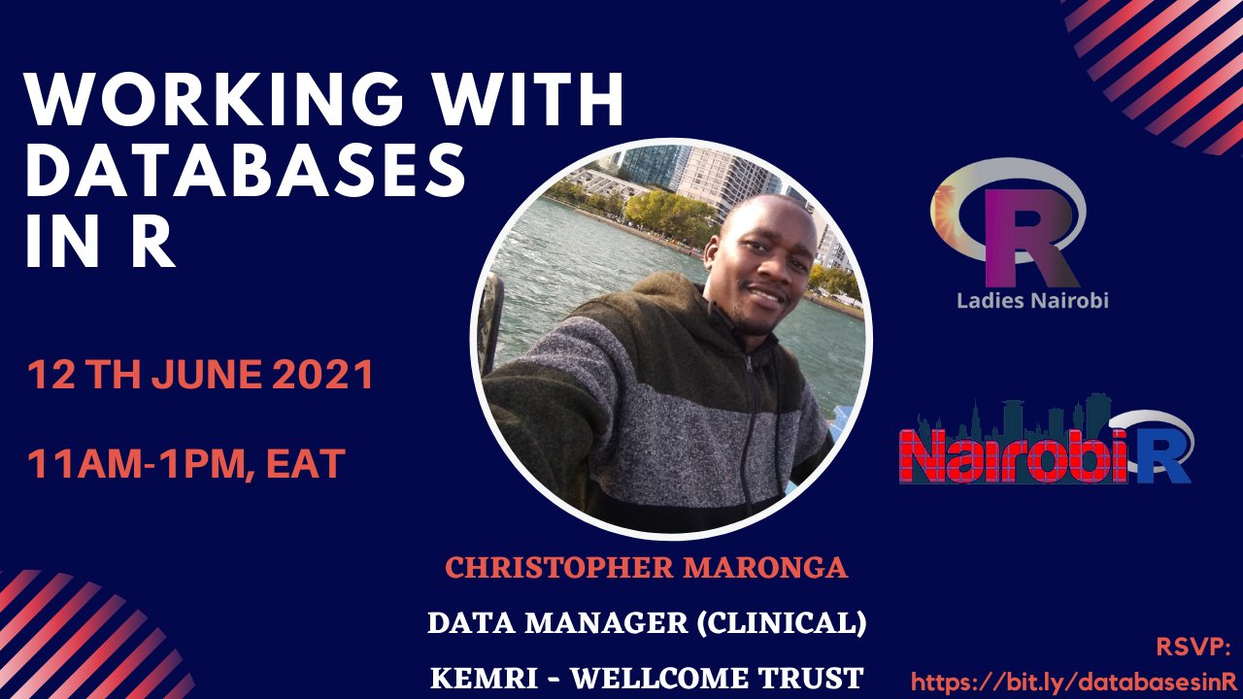
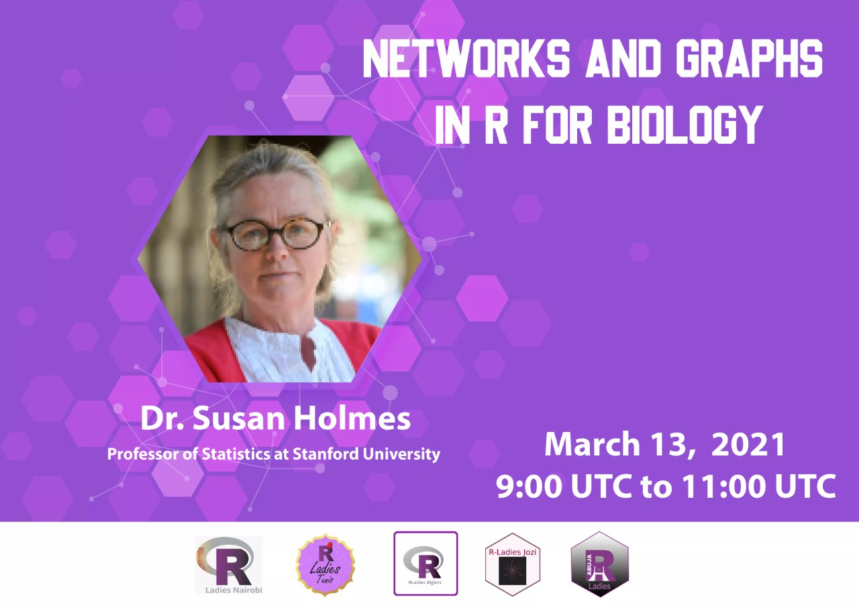
Collaborations with other groups
Notes:
We have collaborated with other R-Ladies chapters in Africa and Nairobi R User Group for events.

Slide 6
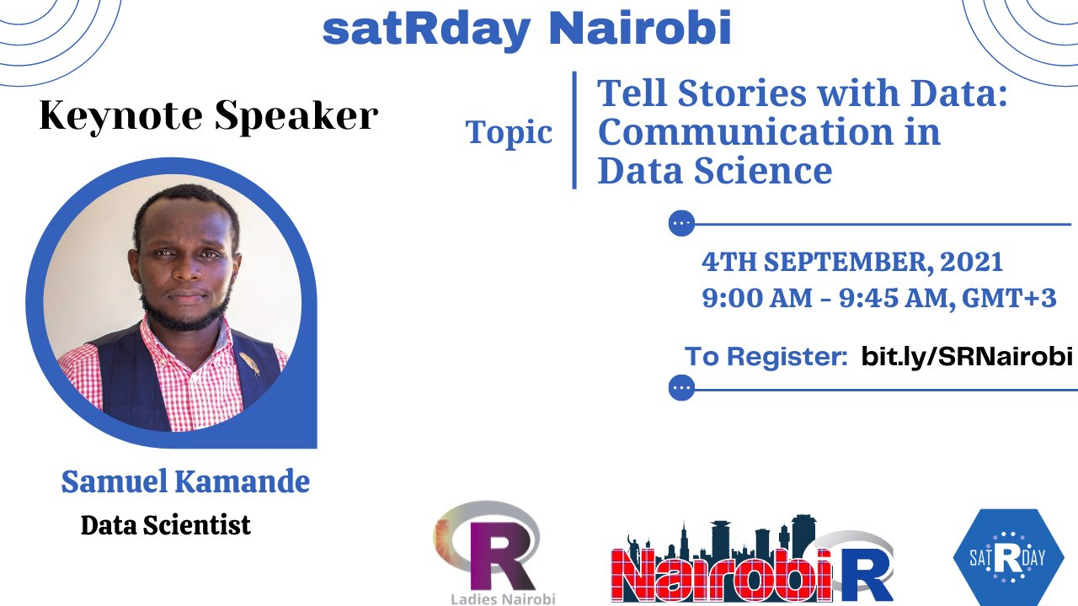

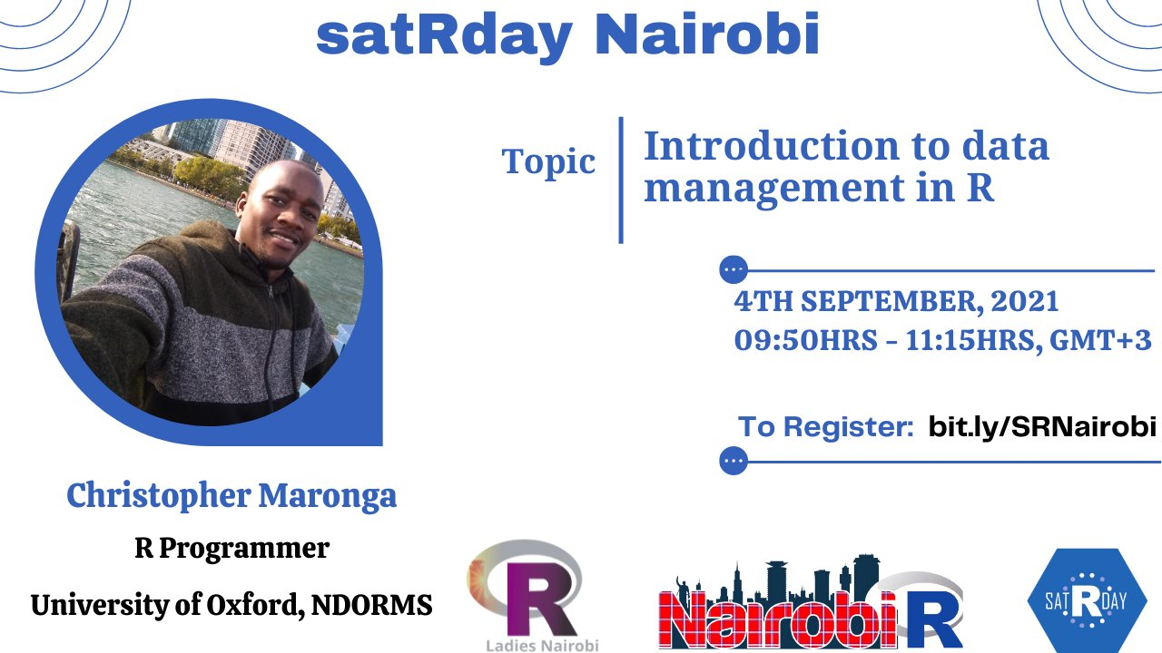
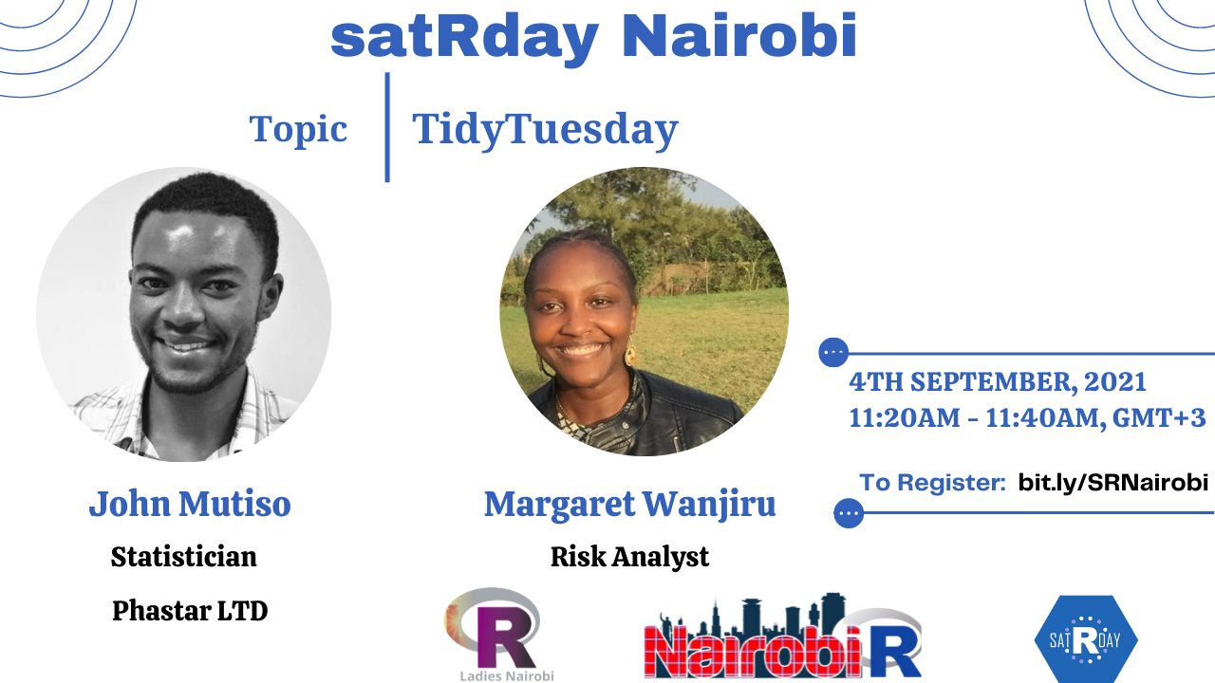
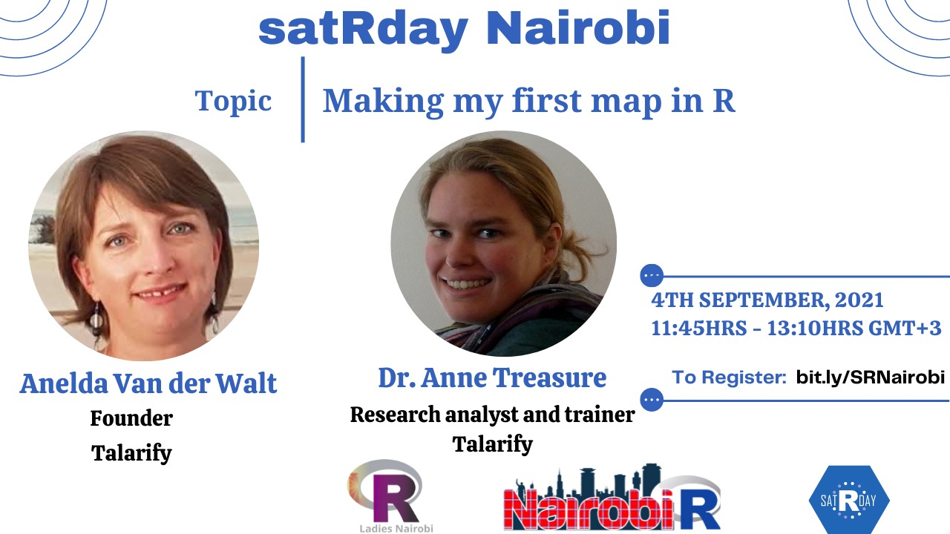
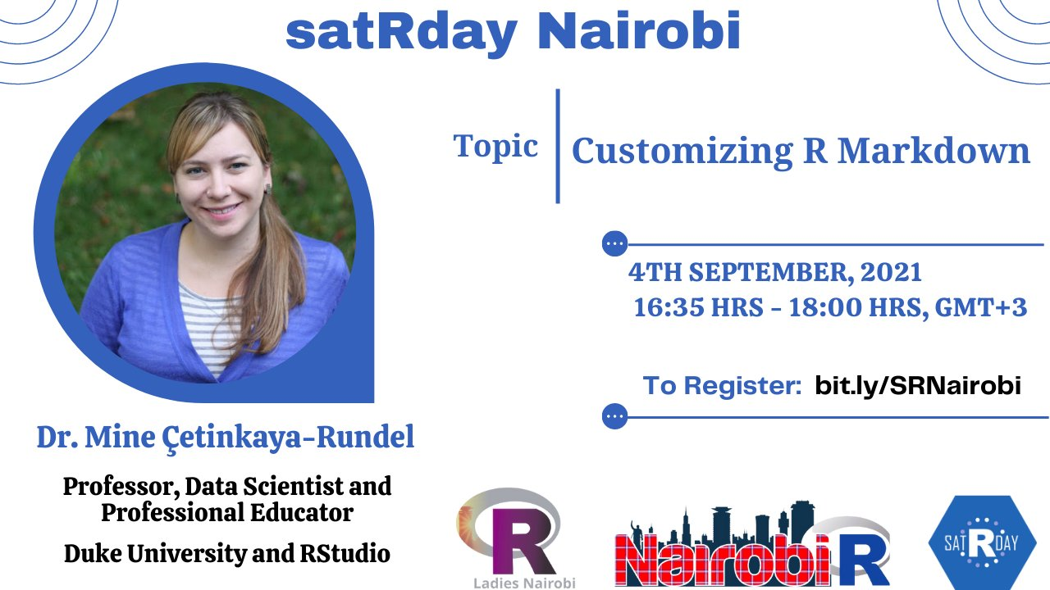
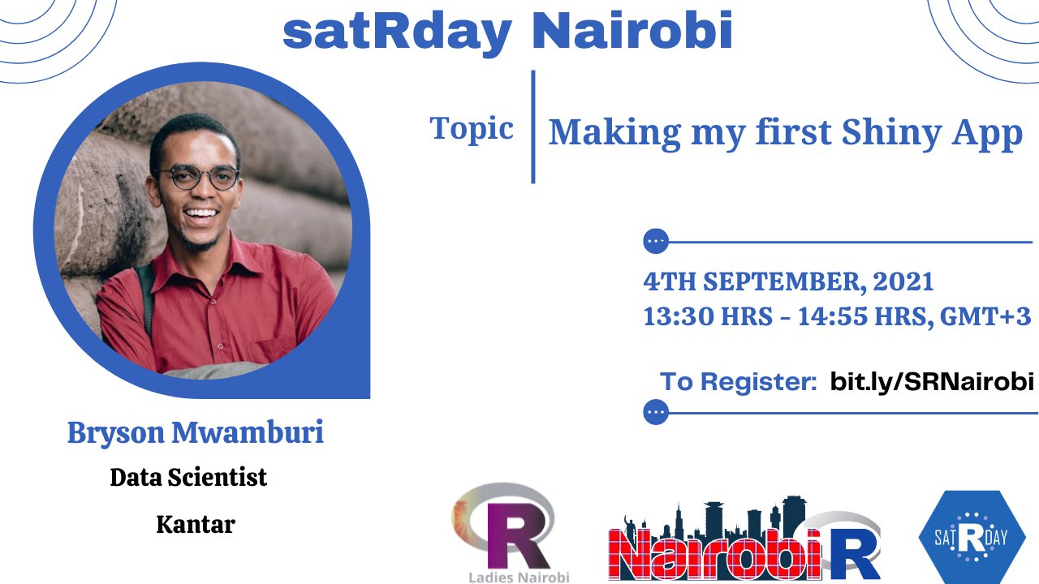
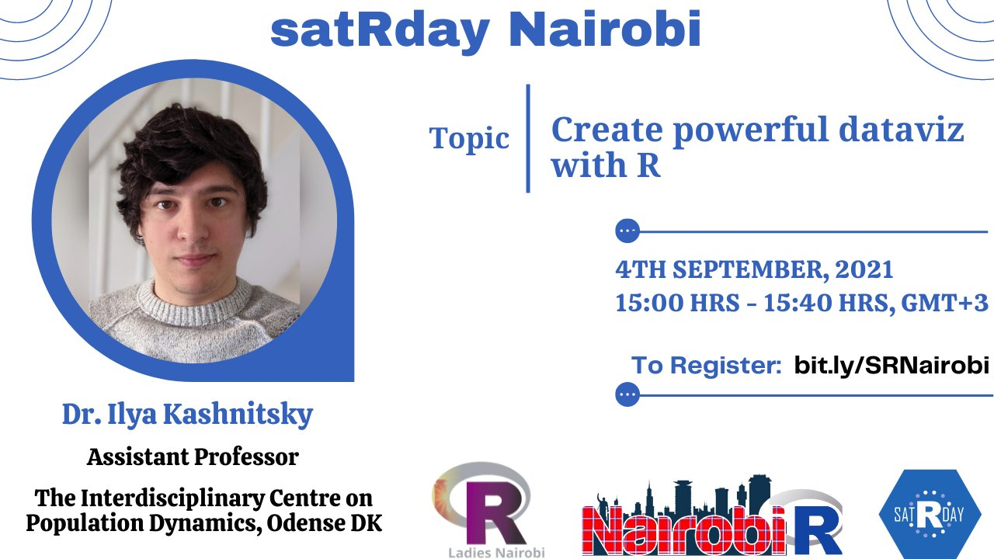
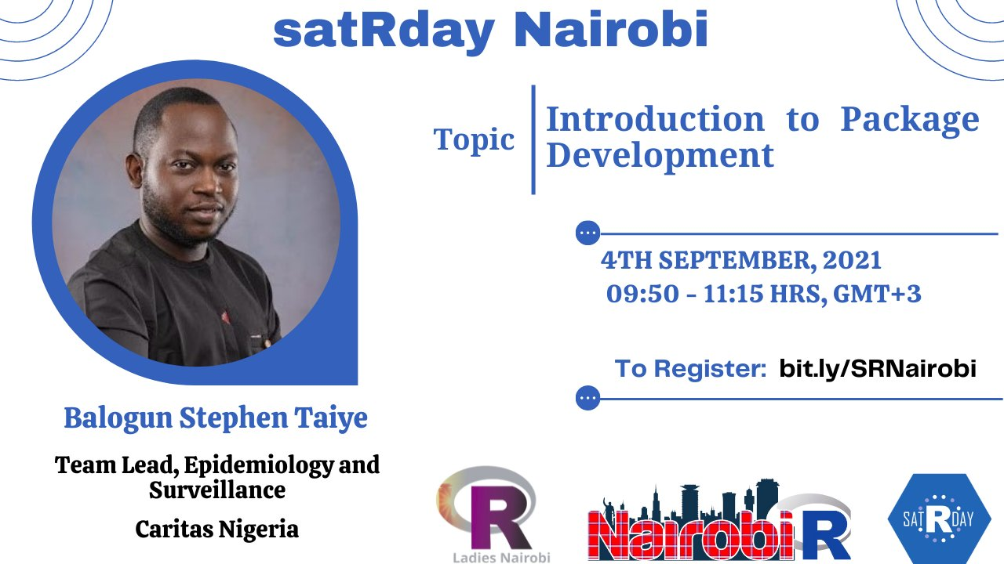
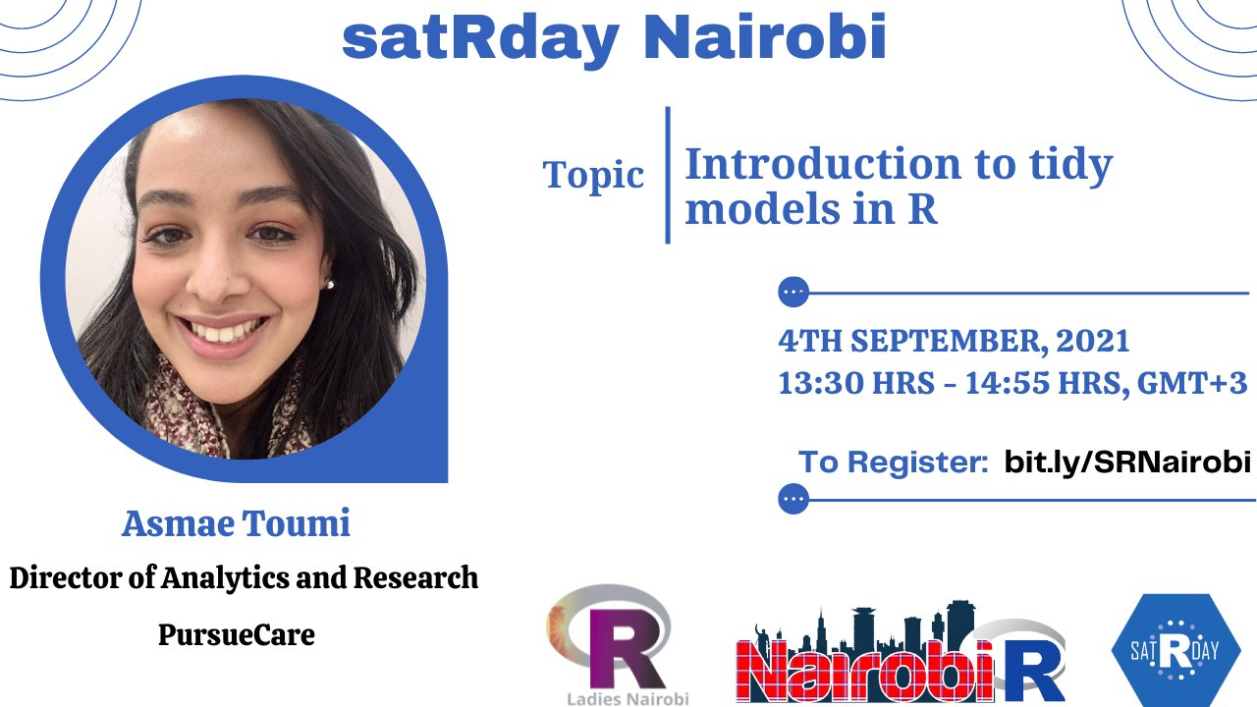
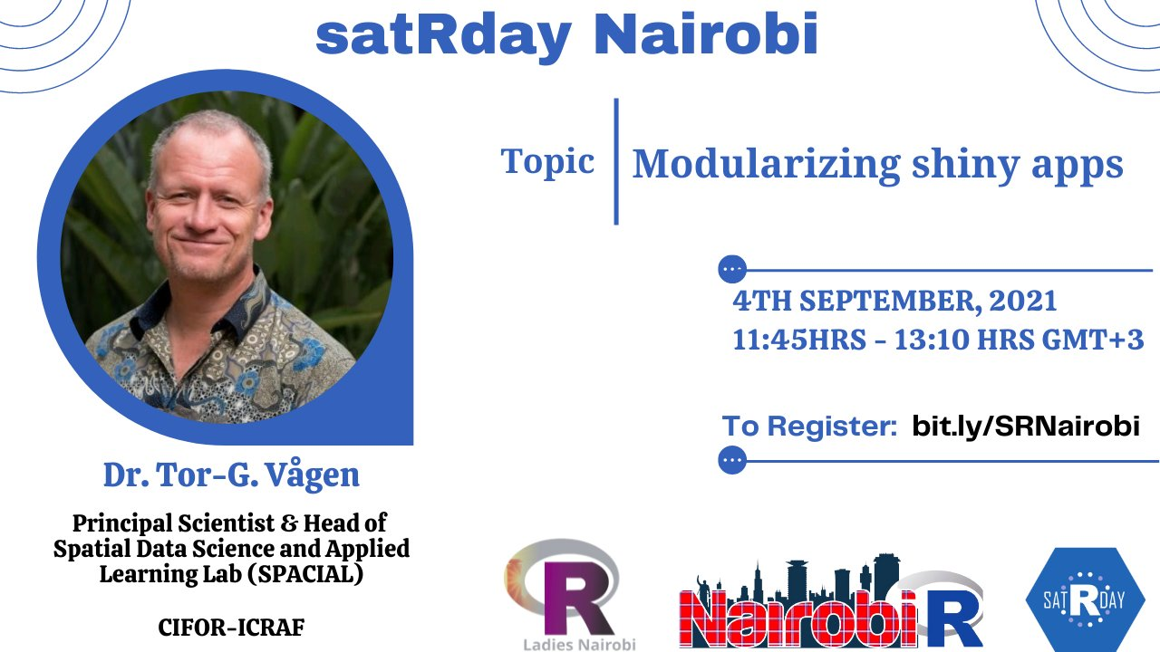

satRday Nairobi conference 2021
R-Ladies Nairobi
#NairobiR
Notes:
Additionally, in collaboration with NairobiR we held the first satRday Nairobi conference 2021.
All our recordings and learning resources are publicly available.

Slide 7
A word from the organisers …

Slide 8
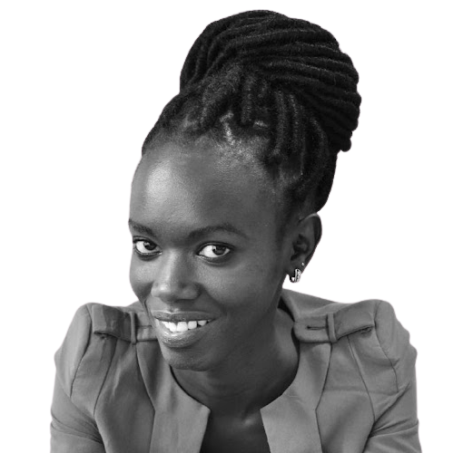
Talk 1: From the bio lab to the data lab
Martha Luka
Computational Biologist, MRC-Center for Virus Research, University of Glasgow

Slide 9
Break: Trivia Game

Slide 10



Q & A panel session

Slide 11
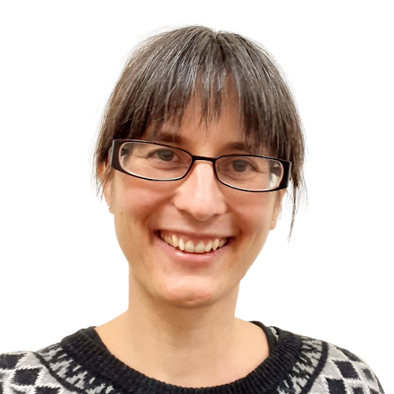
Talk 2: Learning and sharing: some free resources for learning R and some opportunities to give back to the R project/community
Dr. Heather Turner
Research Software Engineering Fellow in the Statistics Department at the University of Warwick, UK

Slide 12
What’s next for R-ladies Nairobi?
Hold monthly virtual meetups
Collaborate with other RUGS and R-Ladies Chapters in Africa and beyond
Hold annual conferences
Notes:
Hold monthly meetups as from January, include trainings, lighting talks, Q&A panel sessions.
Collaborate with R-Ladies chapters outside Africa.
Maintain collaboration with R-Ladies chapter in Africa and Nairobi R User Group.
Hold yearly conference.
We will remain to have virtual meetups:
Allows members from outside to join; all inclusive
Not to restaimed with speakers from locally, also have speakers from other parts of the world.
Workable for the organisers.
In our events and platforms we are guided by the code of conduct provided by R-Ladies Global to ensure that we have a free harassment environment.

Slide 13
THANK YOU
Email address: nairobi@rladies.org
LinkedIn: R-Ladies Nairobi
Twitter: @RLadiesNairobi
Meetup: https://www.meetup.com/rladies-nairobi/

